Slide 1

Veema Education
Safeguarding Updates for International Schools
A practical 20-minute refresher for school leaders
Presented by XXX
August 2026
Notes:
Welcome participants and explain that the session has two purposes: a concise safeguarding update and a practical introduction to the Leadership Hub.
Suggested time: 0:30.
[Sources]
- https://www.gov.uk/government/publications/keeping-children-safe-in-education--2
[/Sources]

Slide 2

Purpose and scope
The safeguarding changes leaders need to know
Practical actions for the start of term
Getting the Most from the Leadership Hub
Questions that support leadership assurance
Notes:
Explain that KCSIE is statutory guidance for schools and colleges in England. International schools may use it as a strong benchmark, but must apply it alongside host-country law, regulatory requirements and local referral arrangements. KCSIE 2026 comes into force on 1 September 2026; KCSIE 2025 remains in force until 31 August.
Suggested time: 1:00.
[Sources]
- https://www.gov.uk/government/publications/keeping-children-safe-in-education--2
[/Sources]

Slide 3
As international schools, you will:
Draw on UK best practice, including Keeping Children Safe in Education (KCSIE), where appropriate.
Comply with the safeguarding laws and regulations of the country in which you operate.
Seek guidance and support from organisations such as Veema, COBIS, FOBISIA and BSME.
Follow the safeguarding requirements and standards set out within your relevant inspection and accreditation frameworks.
Have robust policies, procedures and practices in place to help keep children, staff and families safe.
Use a Single Central Record (SCR) to record all required safer recruitment and vetting checks.
We all have a responsibility to safeguard young people at school, at home and online regardless of their background or circumstances.

Slide 4
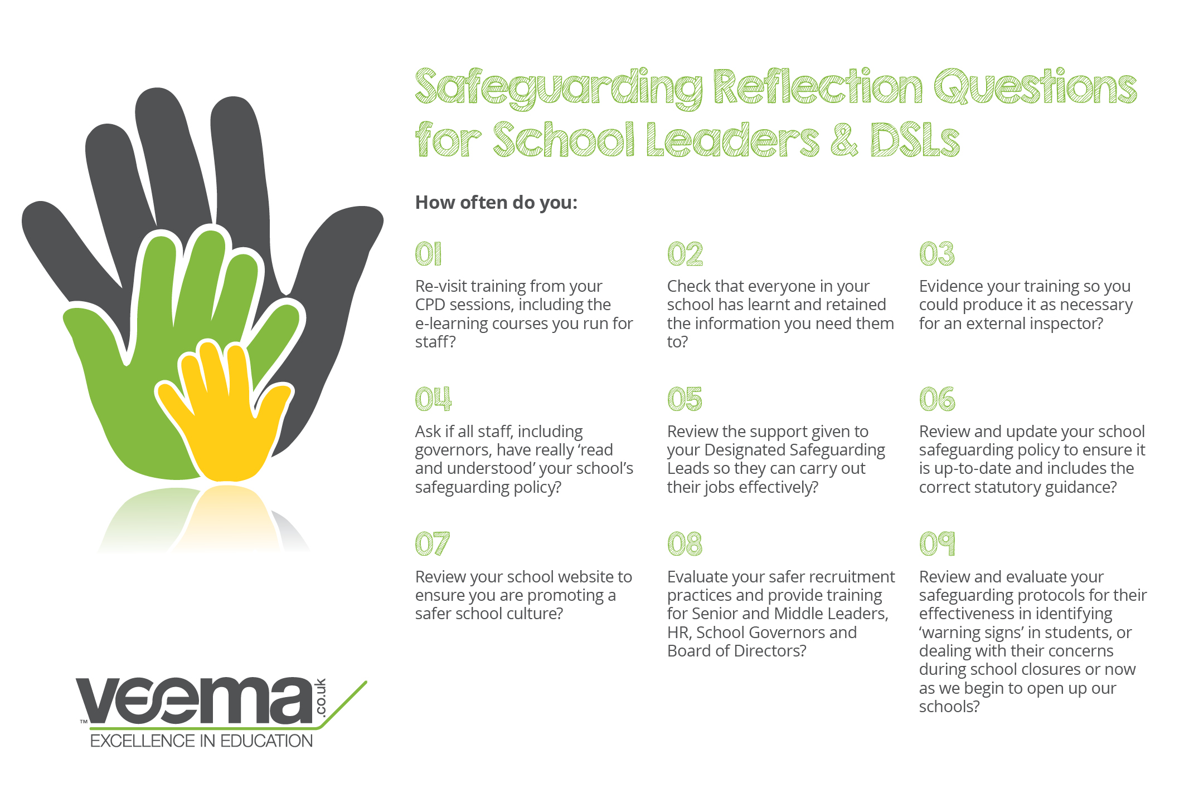

Slide 5

KCSIE 2026: Seven Practical Priorities
Part one for all staff
Family Help and local assessment routes
Online safety, generative AI and mobile phones
Filtering and monitoring effectiveness reviews
Regulated activity and safer recruitment
Information sharing and robust DSL cover
Child-on-child abuse and harmful sexual behaviour
Notes:
Introduce the seven operational priorities. Make clear that this is a selected leadership overview rather than an exhaustive account of Annex C.
Suggested time: 1:00.
[Sources]
- https://assets.publishing.service.gov.uk/media/6a4cf903b7203c4c023fd2f3/Keeping_children_safe_in_education_2026_.pdf
[/Sources]

Slide 6

Part one and earlier help (Best Practices from the UK)
All staff should read Part one in full
The former condensed Annex A has been removed
A quick-reference overview supplements—but does not replace—Part one
Staff should understand community-based early help, Family Help and local assessment routes
Notes:
The condensed Annex A has been removed. Governing bodies and proprietors should ensure all staff, including those who do not work directly with children, read Part one. The DfE overview is a quick reference only. Explain how Family Help terminology distinguishes community-based help from targeted early help. International schools should map this principle to their local arrangements.
Suggested time: 1:30.
[Sources]
- https://www.gov.uk/government/publications/keeping-children-safe-in-education--2
- https://assets.publishing.service.gov.uk/media/6a4cf903b7203c4c023fd2f3/Keeping_children_safe_in_education_2026_.pdf
[/Sources]

Slide 7
Online safety: clearer leadership checks
New guidance on safe and effective use of generative AI
A new section on mobile phone policy
Updated categories of online risk
Annual review of filtering and monitoring effectiveness
Checks across devices and locations—with a record retained
Notes:
Emphasise the operational nature of these changes. The annual effectiveness review should be led by the responsible SLT member with DSL and IT support. Checks should cover internet-connected devices in relevant locations and be recorded.
Suggested time: 1:30.
[Sources]
- https://assets.publishing.service.gov.uk/media/6a4cf903b7203c4c023fd2f3/Keeping_children_safe_in_education_2026_.pdf
[/Sources]

Slide 8
Safer recruitment and regulated activity
The supervision exemption for volunteers has been removed
Volunteer and work-experience sections have been rewritten
DBS expectations now reflect the revised regulated-activity definition
Further clarification covers self-employed people, visitors and duties to refer
Notes:
Explain that removal of the supervision exemption changes when volunteers are in regulated activity. Schools should update recruitment procedures rather than relying on old flowcharts. International schools should check local vetting law while retaining equivalent safeguards.
Suggested time: 1:30.
[Sources]
- https://assets.publishing.service.gov.uk/media/6a4cf903b7203c4c023fd2f3/Keeping_children_safe_in_education_2026_.pdf
[/Sources]

Slide 9
Information sharing and DSL cover
Share information using a proportionate, risk-assessed approach
Record concerns, discussions, decisions and rationales
Record when referrals were or were not made
Maintain robust DSL cover when the DSL is unavailable
Ensure staff know the local escalation route
Notes:
Good safeguarding records show not only what happened, but why a decision was made. Highlight continuity when the DSL is absent and the importance of clear escalation arrangements.
Suggested time: 1:15.
[Sources]
- https://assets.publishing.service.gov.uk/media/6a4cf903b7203c4c023fd2f3/Keeping_children_safe_in_education_2026_.pdf
[/Sources]

Slide 10
Child-on-child abuse: prevention and response
A safeguarding issue for both the victim and alleged perpetrator
Preventable not an inevitable part of growing up
May include serious violence or threats involving weapons
All sharing of nudes or semi-nudes requires a safeguarding response
Part five now shows the continuum from harmful behaviour to sexual violence
Notes:
Part five has been substantially rewritten. Stress prevention, the needs and safeguarding of both children, and the requirement for a safeguarding response whenever nudes or semi-nudes are shared.
Suggested time: 1:30.
[Sources]
- https://assets.publishing.service.gov.uk/media/6a4cf903b7203c4c023fd2f3/Keeping_children_safe_in_education_2026_.pdf
[/Sources]

Slide 11
Other changes leaders should note
Modern slavery and financial exploitation
Mental health, serious violence and young carers
Additional barriers for children with SEND or medical conditions
LGB and gender-questioning children (controversial)
Sport, premises, residential settings and reasonable force
Alternative provision and temporary accommodation notifications
Notes:
Briefly signpost these additional changes. Do not attempt to teach each area in this short session; direct leaders to the full guidance and Hub materials for follow-up.
Suggested time: 1:00.
[Sources]
- https://assets.publishing.service.gov.uk/media/6a4cf903b7203c4c023fd2f3/Keeping_children_safe_in_education_2026_.pdf
[/Sources]

Slide 12
A practical September checklist
Confirm all staff will receive and read Part one
Update safeguarding policies and local referral routes
Review DSL and deputy cover arrangements
Check AI, mobile phone, filtering and monitoring arrangements
Update volunteer and regulated-activity procedures
Refresh child-on-child abuse training
Check that decision rationales are consistently recorded
Notes:
Present this as an actionable audit list. Invite leaders to identify which two actions require immediate attention in their setting.
Suggested time: 1:15.
[Sources]
- https://www.gov.uk/government/publications/keeping-children-safe-in-education--2
- https://assets.publishing.service.gov.uk/media/6a4cf903b7203c4c023fd2f3/Keeping_children_safe_in_education_2026_.pdf
[/Sources]

Slide 13


What You’ll Find on the Leadership Hub

Slide 14

The Leadership Hub: Practical Support
On-demand resources for international and independent schools
Safeguarding updates and termly INSET packs
Adaptable templates, checklists and guidance
Resources to support evidence, review and improvement
Notes:
Transition from statutory updates to implementation support. Explain that the Hub is continuously updated and includes dedicated international-school content.
Suggested time: 0:45.
[Sources]
- https://veema.co.uk/the-leadership-hub-for-schools/
[/Sources]

Slide 15

Start with the resources you need most
Safeguarding updates and policy guidance
Termly training and staff briefing packs
DSL tools and safeguarding audit checklists
Online safety and safer recruitment resources
Low-level concerns and incident-response guidance
Scenario-based activities for staff discussion
Notes:
Use this point for a brief on-screen walkthrough of the Hub if access is available. Show where safeguarding materials sit and how a leader can move from an update to a staff briefing or checklist. Only name resources that are currently available to members.
Suggested time: 2:00.
[Sources]
- https://veema.co.uk/the-leadership-hub-for-schools/
[/Sources]

Slide 16
Turn resources into professional development
Use one resource in a weekly briefing
Build short, regular micro-learning into the term
Discuss scenarios rather than simply reading slides
Adapt materials to local law and school procedures
Record participation, reflection and resulting actions
Revisit learning through supervision and quality assurance
Notes:
Model a simple cycle: select a resource, adapt it to context, discuss it with staff, record participation and actions, then revisit impact. Emphasise that uploading or sharing a resource is not the same as professional learning.
Suggested time: 1:15.
[Sources]
- https://veema.co.uk/the-leadership-hub-for-schools/
[/Sources]

Slide 17
Six leadership assurance questions
Has every member of staff read and understood Part one?
Are local referral and escalation routes clear?
Is DSL (or equivalent) cover reliable at all times?
Do records explain decisions and rationales?
Are filtering and monitoring checks evidenced?
Can leaders show how training changes practice?
Notes:
Use these questions as a rapid self-evaluation. Leaders do not need to answer publicly, but should identify where assurance currently depends on assumption rather than evidence.
Suggested time: 1:00.
[Sources]
- https://assets.publishing.service.gov.uk/media/6a4cf903b7203c4c023fd2f3/Keeping_children_safe_in_education_2026_.pdf
[/Sources]

Slide 18
Your next steps
Identify the KCSIE changes relevant to your setting
Check them against host-country law and local procedures
Use the Leadership Hub to brief and develop staff
Record the assurance activity completed
Keep safeguarding visible throughout the terms.
Notes:
Close by reinforcing that the aim is not to memorise every paragraph. Leaders should understand the change, translate it into local practice, brief staff and retain proportionate evidence of implementation.
Suggested time: 0:45.
[Sources]
- https://www.gov.uk/government/publications/keeping-children-safe-in-education--2
- https://veema.co.uk/the-leadership-hub-for-schools/
[/Sources]

