Slide 1
Veema Education
No surprises: Turning Summer Results into Clear School Improvement
Presented by Dr Julia Batters
Date: June 2026

Slide 2
Key Focus Areas
Planning ahead with SLT and middle leaders before results are released
Setting clear priorities in advance
Avoiding reactive approaches to results
Engaging governors in understanding outcomes
Practical strategies to strengthen post-results planning

Slide 3
My background
Former Head of Secondary, British School of Paris
Over 30 years experience in leadership roles, most of career in France
Head of Faculty, Senior Teacher, Deputy Head, Head of School
Educational consultant – Veema, COBIS
Facilitator for iNPQSL, British School of the Netherlands
The British School of Paris:
Non-selective entry – British education as a service to the local community……..comprehensive intake, EAL, SEND, over 50 nationalities
ISI inspection ‘quality of learning and achievement … excellent’, ‘quality of personal development …excellent’

Slide 4
No surprises
Avoid panic
make sure students, parents and staff know what to expect when preparing for the exam season
Examination timetables, locations, what to do if ill etc
Conduct in the examination room
When and how to collect results
What happens after results

Slide 5
Publish widely
Give information to examination candidates,
send home,
publish in the newsletter,
put physical copies on noticeboards,
share with staff

Slide 6
What happens when results are published
“Relevant centre staff must be fully aware of the post-results process, including the published deadlines for clerical re-checks, reviews of marking and reviews of moderation.
Centres must make candidates aware of the arrangements for clerical re-checks, reviews of marking and reviews of moderation prior to the issue of results. Candidates must be provided with written information on the arrangements.”
jcq.org.uk

Slide 7

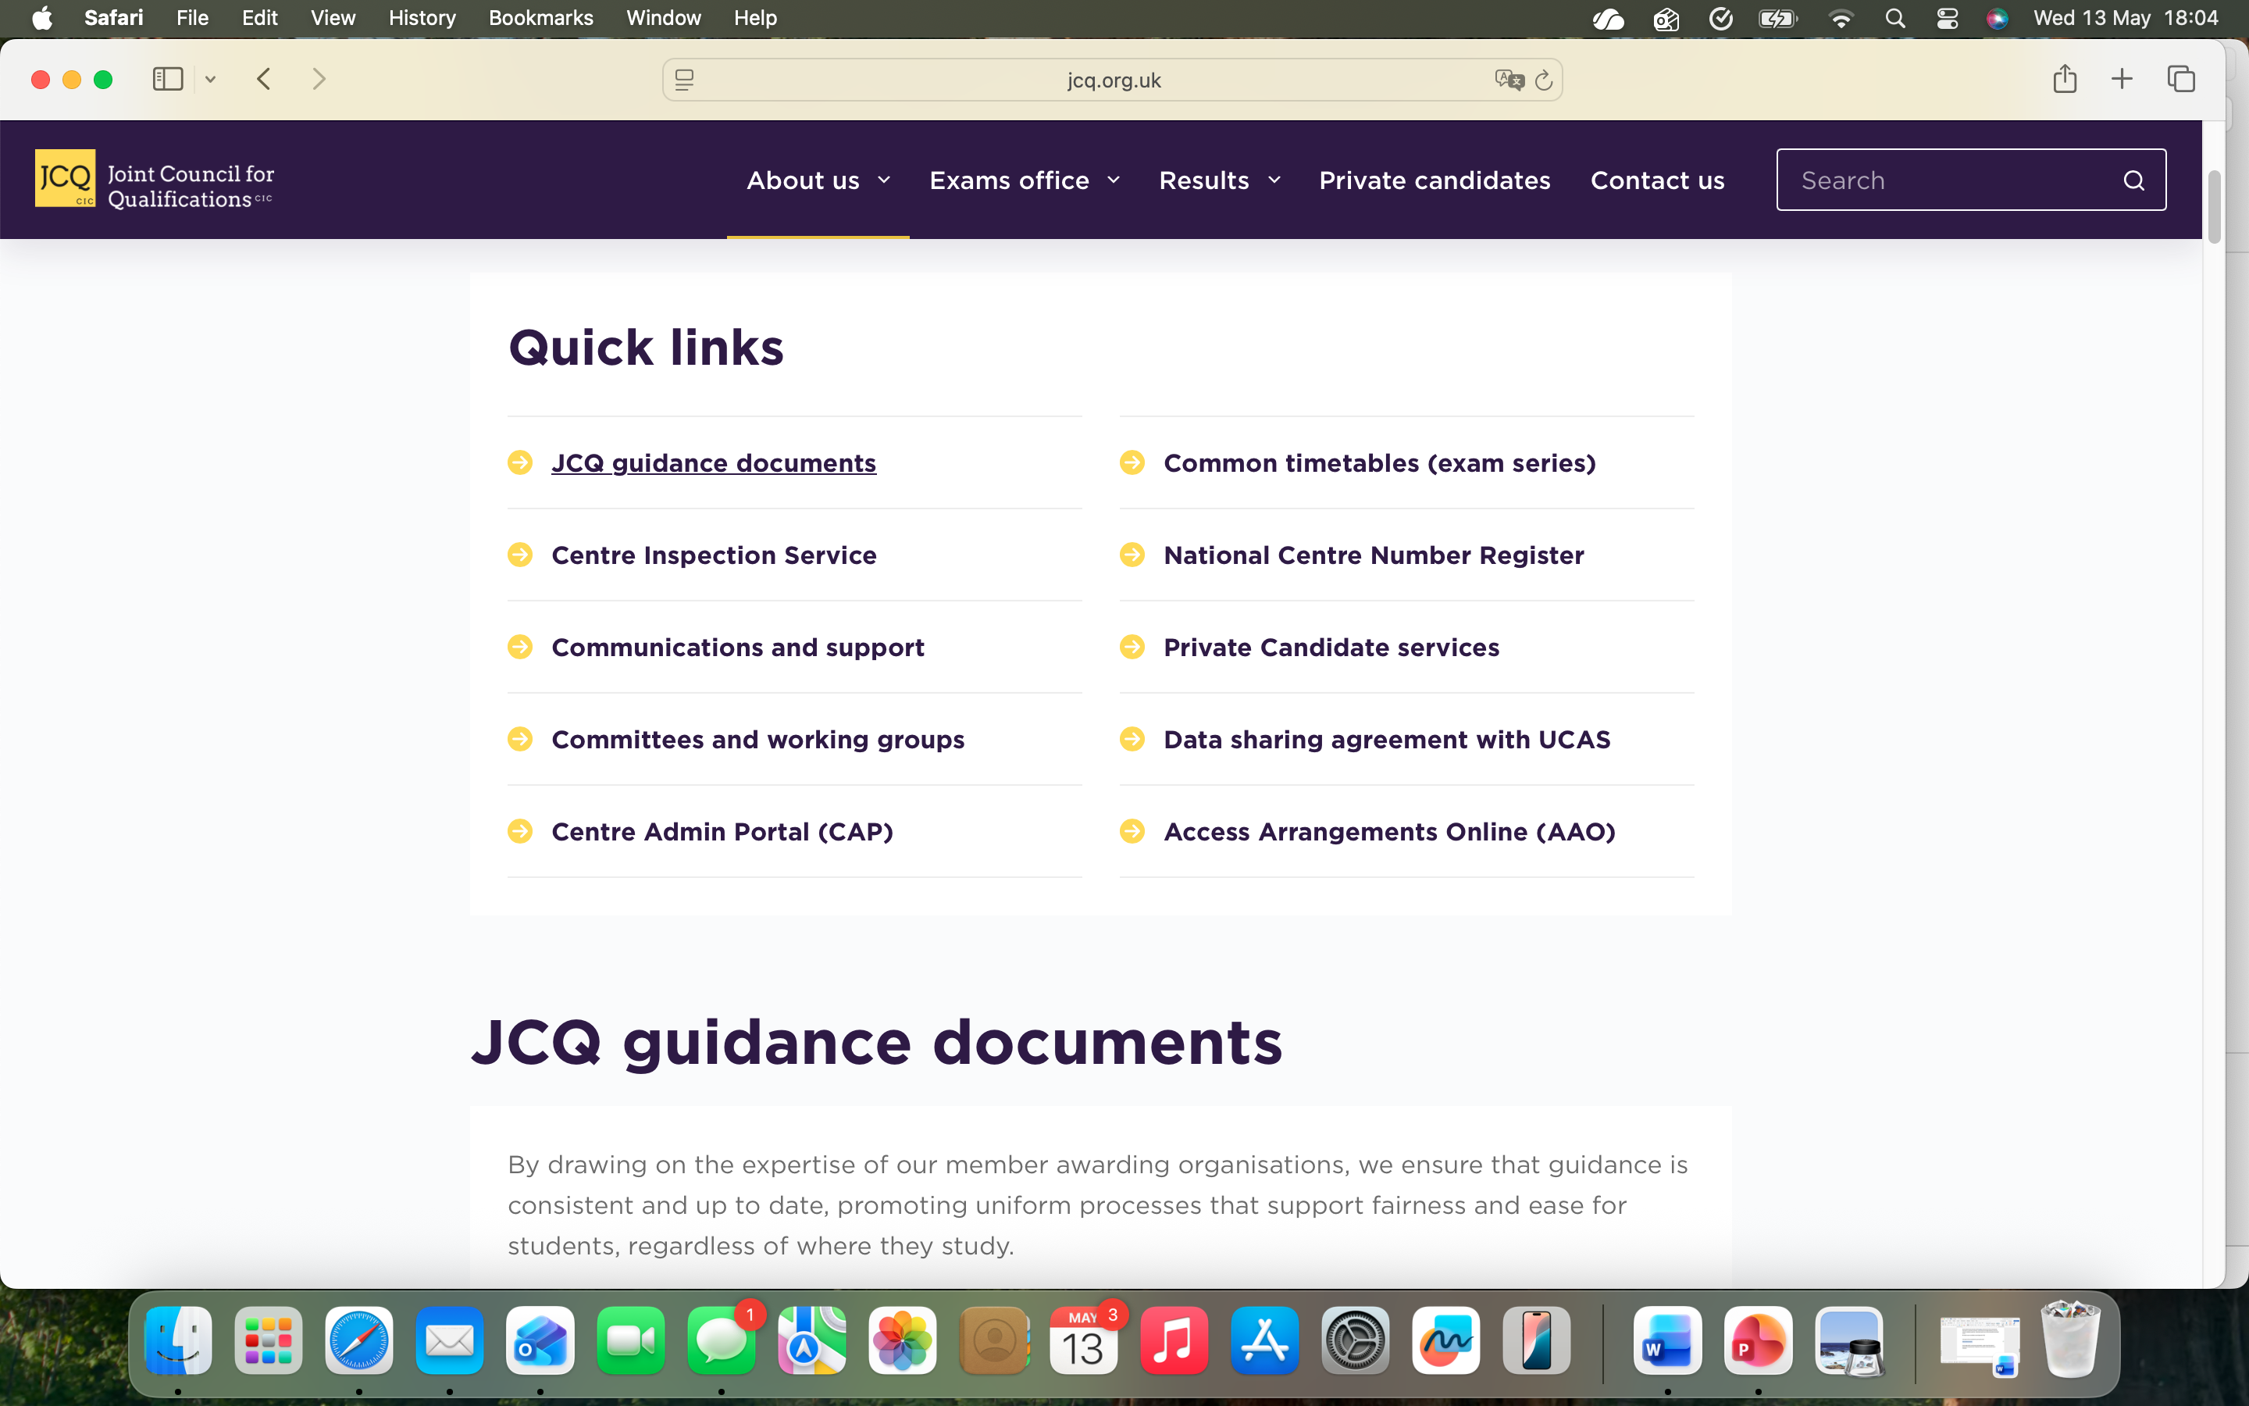
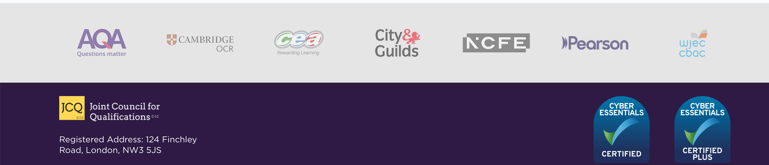
https://www.jcq.org.uk
……represents leading awarding organisations offering qualifications in the UK. These qualifications include GCSEs, A levels, as well as vocational and technical qualifications.

Slide 8
JCQ’s main guidance documents include:
A guide to the awarding organisation’s appeals processes
A guide to the special consideration process
Access arrangements and reasonable adjustments
General regulations for approved centres
Instructions for conducting coursework
Instructions for conducting examinations
Instructions for conducting non-examination assessments – GCSE and GCE qualifications
Instructions for conducting non-examination assessments – vocational and technical qualifications
Key dates in the examination cycle – 2026
Post-Results Services – information and guidance to centres
Suspected Malpractice – policies and procedures

Slide 9
Post Results Services
An overview of the post-results services process
Reviews of Results (clerical re-check, review of marking and appeals)
  Service 1 (Clerical re-check)
  Service 2 (Review of marking)
  Priority Service 2 (Urgent review of marking when a candidate’s place in
higher education depends on the outcome)
  Service 3 (Review of moderation)
Access to Scripts

Slide 10
Fees may apply
Fees for post-results services (Access to Scripts, clerical re-checks, reviews of marking and reviews of moderation) are set and published independently by each awarding body.
School policy about covering costs for post-results actions?
Are parents charged? Does school pay?
Set out policy and publish in advance

Slide 11
Plan ahead with SLT and Middle Leaders before results are released to students
A-level results are usually released on the second Thursday in August, this year 13 August from 8am
May IB exam session results are usually released in early July, this year July 6, 2026,from 12:00 noon (UK time)
Restricted Release (Schools Only): the day before
This allows schools to check results, process data, and prepare for appeals or advice sessions before students receive their grades
opportunity school holiday

Slide 12
Plan ahead to make the most of restricted release
Collect information while staff are still in school
Collect predicted grades for examination candidates (final assessment of the year/report writing time)
Have ready any standardised data you have which suggests likely performance ie CEM performance indicators
Know university grade offers for final year students
Know option choices for those moving from GCSE to A Level
Collect any other useful ‘local’ knowledge
Create a school document ahead of time with space for final grades/further information

Slide 13
Set clear priorities in advance
Plan and share strategies in advance
For example, possible stategies:
SLT will request Reviews of Results (RoRs)
  if grades are two lower than expected according to staff predictions
  if candidates have missed a university place and are near an upper grade boundary
SLT will arrange a meeting with student/parents if option choices are in doubt

Slide 14
Avoid reactive approaches to results
Invite a small number of relevant staff/governors to join SLT/exams officer in a pre-results day meeting to see results in restricted release
  respect confidentiality (print results and allow no copies to leave the premises!)
  Timing? Exams officer and one SLT together first to transfer results to your useable school format that allows you to document action needed
  Decide who is doing what on the day students get their results, who will support which students
  Have a policy in place which deals with potential conflicting different views on how to proceed – consistency of approach from school staff

Slide 15
Decide the best way for your school to handle results day
Encourage students to come into school to celebrate or get help?
Deal with everything by email/phone?
Publish strategy to all well ahead of time
Beware - Some students will access their results online or will know from their university that their place is confirmed or declined ahead of receiving results from the exam board

Slide 16
Results day
Celebration and photo space (opportunity for school website)
Private space / tissues
Access to computers/phones
Action plan (decided the day before) - a priority for upset families
Have paper copies ready to secure candidate consent for post results action
JCQ Post Results Services
Appendix A – Clerical re-checks, reviews of marking and appeals - candidate consent form
Appendix B – Access to Scripts - Candidate consent form for access to and use of examination scripts

Slide 17
Deadlines
Be aware of, and make staff, students and parents aware of, time constraints for post results action
DEADLINE for awarding bodies to receive requests for Priority Service 2 reviews of marking:
One week after publication of results
DEADLINE for Reviews of Results (RoRs)
DEADLINE for copies of scripts to support teaching and learning
Last date for awarding bodies to receive requests usually late September

Slide 18
Longer term impact: turn summer results into clear school improvement by strengthening teaching and learning

Slide 19
Strengthen Teaching and Learning
request ATS
Use the interactive results analysis tools provided by exam boards to review student performance against national averages and previous years. These platforms allow teachers to drill down from school-level data to individual question, topic, and assessment objective performance to identify strengths and weaknesses
ML should also be commenting on what they have learned from exam board analysis and how this informs future practice
Veema Assessment Checklist: Exam Results and Preparing for the New Term

Slide 20
Examination analysis and future practice
Most schools will require an examination report from academic middle leaders
Useful to focus on moving forward

Slide 21
GCSE- History Unit 3- Technique workshops- particularly with Unit 3
Exam board feedback- examiners report analysis
Using exam papers
Concentrating on pushing key word terminology and content
A level- Politics Unit 3 exam board feedback/INSET and examiners reports.
Use of papers as examples of success A*
Geog – More help with coursework and focus on improving the coursework grades
1) GCSE - model answers for 9,8,7 will be peer-marked by current Y11s (who have already seen this paper for their EOY assessment)
2) A Level - ex - examiner for Edexcel giving a day's CPD to Geography GCSE and A Level teachers in December
3) A Level Unit 4 will be done only in Year 13.
Business numeracy/mathematics needs pushing:
ARR question was poorly executed by Yr13
Examiners reports highlight the importance of this at GCSE and A level. These formulae will now feature prominently in tests and wall displays
FRENCH
Paper one does require increased attention or further thought in our view (this is a view also shared by German and Spanish); we do need to ensure that all bases are covered in the case of shared classes, and we do need to practise Listening and Reading comprehension skills more extensively. There might be a need to train our more confident linguists to be as discerning as possible rather than hastily write down answers to subtle comprehension questions.

Slide 22
Policy and practice document
Another one!
Examination results day is always emotional, can be stressful and panicky so its a
good idea to put all your practices and strategies into one document to support you with these procedures every year

