Slide 1
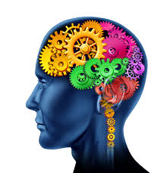
Unit 1 Lesson 1
Understanding Emotional Wellbeing and Mental Health
Connect with us
Twitter: @VeemaEdu Facebook: Veema Education Website: Veema.co.uk

Slide 2
Notes:
Teacher Notes
Use this slide to display or establish your class agreement/ground rules for the lesson. It is important to ensure that students all know they have a right to pass if they are asked to answer a question which might be sensitive, and that there should be no personal stories.

Slide 3
Today we are learning:
What the terms ‘emotional wellbeing’ and ‘mental health’ refer to
About stress and the impact it has on our wellbeing
Some coping strategies to better manage our emotions and deal with stress
We will be able to:
Recognise what mental health is and emotional wellbeing in comparison to mental ill health
Explain what healthy stress is and how too much stress can be detrimental
Use various coping strategies to manage stress levels and cope with emotions
Notes:
Teacher Notes - learning objectives and outcomes
Introduce the learning objectives and outcomes. Explain that during today’s lesson there will be various activities/tasks they will engage in and videos they will be watching.

Slide 4
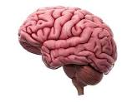
Brainstorm
“What do you think the term MENTAL HEALTH refers to?”
Notes:
Teacher Notes (10 min) flipchart activity:
Get students into groups of 4/5 and ask them to brainstorm what they think mental health means. Each group will be provided with a flipchart paper. Ask students to share their views by displaying their flipchart papers to the rest of the class – these can be held up or stuck onto the wall. The next slide is to be shown once they have shared their ideas.

Slide 5
What do you Think?
Mental health, emotional wellbeing and mental illness can sometimes be lumped in the same box – so what’s the difference?
Mental health refers to cognitive, emotional and behavioural wellbeing. It is all about how people think, feel and behave.
Emotional wellbeing refers to feeling good and functioning well collectively and as individuals.
Mental illness means a condition diagnosed by a medical professional that significantly interferes with an individual's cognitive, emotional or social abilities. It is when a person is struggling to manage their thoughts, behaviours, perceptions or emotions.
Notes:
Teacher Notes:
Read the slide to the class and explain that the word ‘mental’ simply means that we all have a brain, and this is where our thoughts originate from. This is the basis of mental health, as our thoughts affect our perceptions (how we see things/view situations), which in turn affect how we feel and then how we behave.
The term ‘emotional wellbeing’ is being used more so now, as there is a growing consensus in psychological research showing that nearly all mental health conditions are rooted in some form of struggle to accept and regulate one’s emotions, which is also referred to as ‘emotional dysregulation.’ Explain that it’s important to understand that we cannot feel happy all of the time and that emotions such as fear, sadness, guilt, anger etc. are all part of life and part of wellbeing, as wellbeing is characterized by our ability to cope with all emotions.
Explain: There are many differences between mental health and suffering from a mental illness. Everyone needs to take care of their mental health, in the same way that people need to take care of their physical health. Mental health is about being emotionally ‘healthy’ and does not always refer to someone with a mental ‘illness’.
Discussion: There are various stereotypes and slang words used to describe mental health. How might these terms affect someone with mental health problems? Are certain people more prone to mental health problems? Why is there such stigma associated with the term ‘mental health’?

Slide 6
True or False?
• We all have mental health.
• Our physical health is more important than our mental health.
• If I want to talk about my mental health, I always have to ask a doctor.
• One way to manage our mental health is to talk about it with someone we trust.
Notes:
Teacher Notes:
Quick true/false quiz to check understanding - Hands up/go through quiz as a class. Can ask students to share their thoughts.
1. True. 2 False 3. False 4.True

Slide 7
A Few Early Signs of Mental Health Issues:
Behaviour/mood changes over days or weeks
Sleep problems: too little or too much sleep
Feeling regularly overwhelmed, anxious, angry
Deliberate isolation from friends and family
Lack of self-care or hygiene habits
Difficulty concentrating, such as not focussing on work
More regular physical health concerns, such as headaches
These things don’t always indicate a mental health issue. Someone could also have a mental health issue without anyone noticing any signs.
Notes:
To share with the class

Slide 8
Stigma
Notes:
Teacher Notes (5-10 min)
Mention that this video focusses on the concept that we all have mental health, that it’s positive and is about living life to the full. Mental health issues are normal, everyone has issues from time to time, just like with physical health. Mental or emotional wellbeing is about our ability to cope with life’s problems and make the most out of life’s opportunities.
Ask students if they have a better understanding of what stigma is (i.e. the negative thoughts we have about something, in this case mental health) and where it comes from. Also ask what messages stood out for them and how we individually and as a society can break stigma and change the way people view mental health, specifically ill mental health.

Slide 9
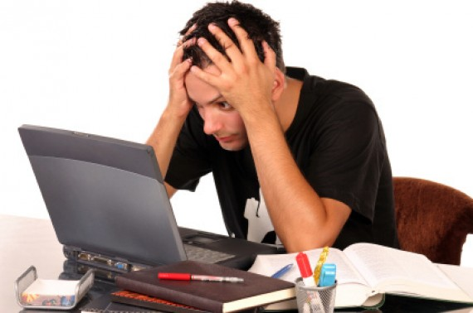
Stress: Know your Limits!
Notes:
Stress can seem like a thick fog, when our brain simply cannot focus, and we can’t seem to find a way out.
Stress is very subjective and differs from person to person. It can creep up on us very easily and sometimes we can even get used to it, we may not even notice at times how much it’s affecting us. There is definitely a healthy side to stress, whereby it at school or work we have to meet deadlines, which increases pressure and will motivate us to become more focussed and work harder, although it can also have the opposite affect and can make people feel worse and prevent them from doing certain things.

Slide 10
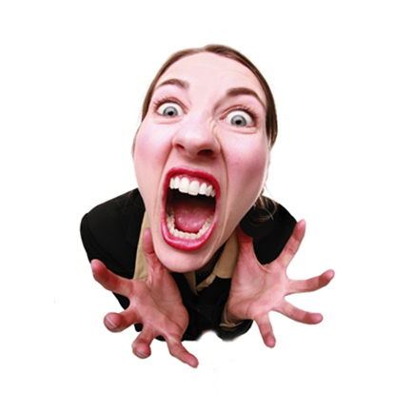
Watch This:
Notes:
Show BBC video to students – ask if anything stood out for them?

Slide 11
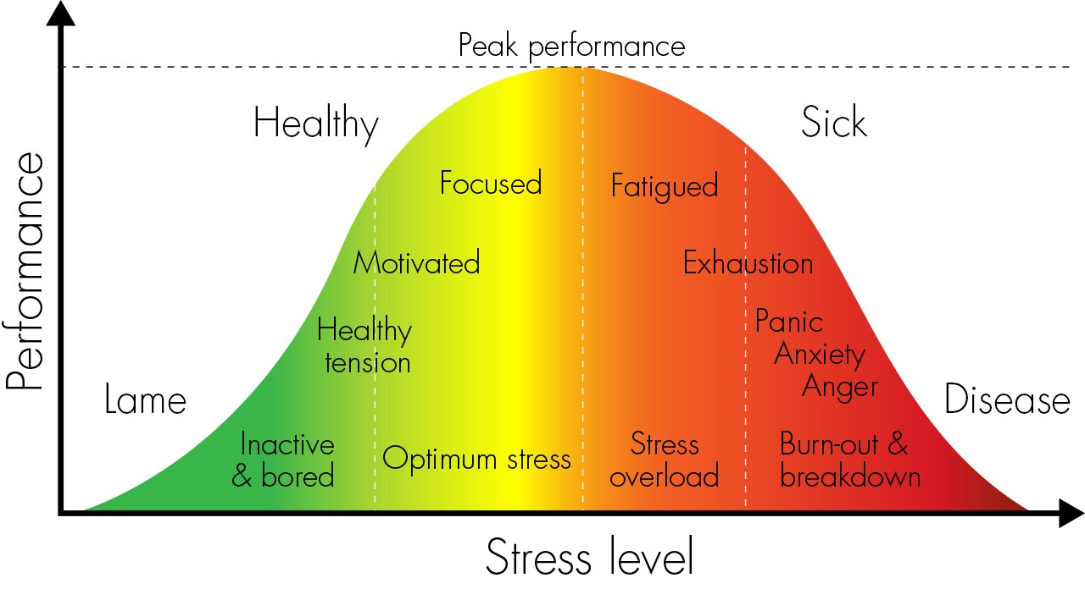
The Yerkes-Dodson Law
Source: The Resilience Factor-The Stress Nest
Notes:
The Yerkes–Dodson law is based on the relationship between pressure and performance, originally developed by psychologists Robert M. Yerkes and John Dillingham Dodson in 1908.
The law dictates that performance increases with physiological or mental stress, but only up to a point, according to what is known as the Yerkes-Dodson Law.
When the level of stress becomes too high, performance decreases. ... Research has found that different tasks require different levels of stress for optimal performance. Cortisol, our stress hormone, is not meant to be in our bodies long-term and if we are chronically stressed, the long-term effects of excessive cortisol in our systems has scientifically proven detrimental to our immune systems. When we put too much pressure on ourselves or others do this to us, we can reach stress overload which can onset panic and anxiety.

Slide 12
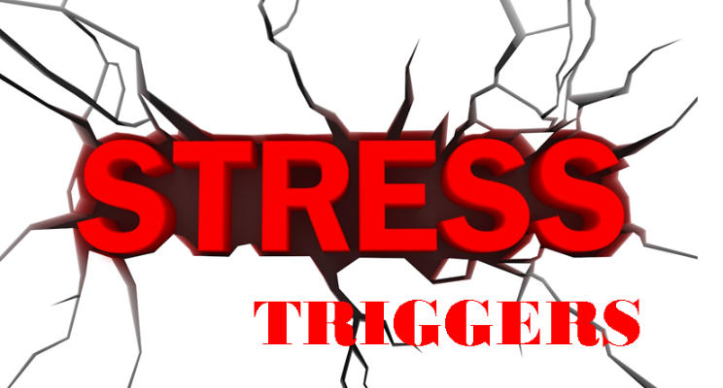
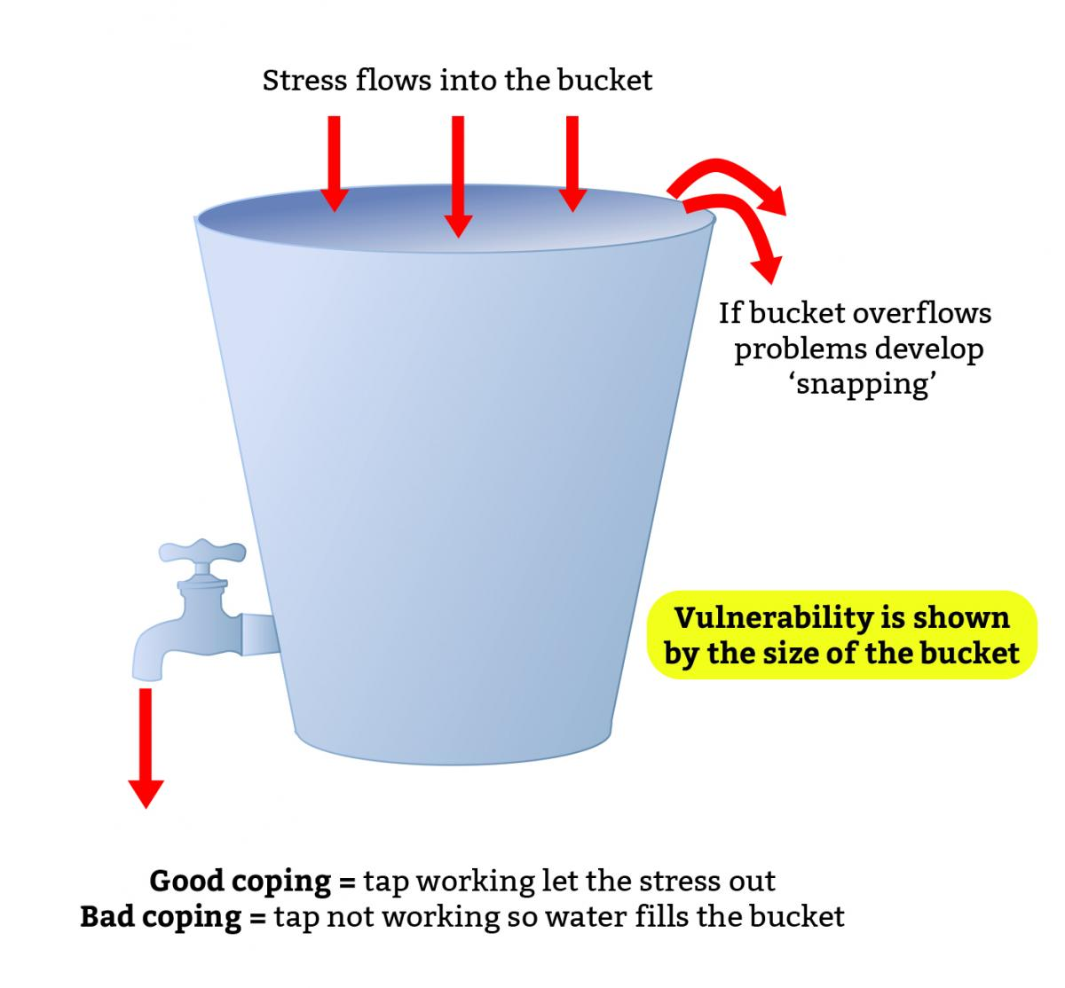
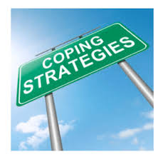
The Stress Bucket
Image from the Charity of Civil Servants
Notes:
Discuss the diagram above, note the tap and release valve which are a metaphor for coping skills.
Think about the size of the bucket- what happens when there is too much stress (water) going into the bucket?
Ask the students to think about the things that could go in the bucket - all the things that contribute to stress in their life, e.g. tests, exams, schoolwork, arguing with siblings, friendships, etc.
Finally, ask them to think about the things they can do to reduce the stress level of our bucket e.g. play sports, walk the dog, listen to music, cook
Students to use their own stress buckets and complete (Just Talk exercise) – mention that Just Talk was a campaign launched in Hertfordshire, a county in England, to specifically encourage boys and men to talk about their mental health, it has grown as a very successful campaign, that now girls and woman have become involved too. There are lots of resources on their website, www.justtalkherts.org
Thirdly, ask the following questions or ask the young person to ask themselves: (time permitting)
Do you have any evidence to support your feelings?
What can you change?
What can’t you change and need to accept?
What needs your urgent attention?
Can anyone help you?
The students can also consider the helpful and unhelpful coping strategies that they employ. Are there any unhelpful strategies that they could reduce and any helpful ones they could increase?
We need to identify strategies that we can use that release the stress and pressure and help things to feel manageable

Slide 13
Positive and Negative Influences on Wellbeing
Knowing when to ask for help | Achieving and not giving up | Exam stress | Bullying & peer pressure
Feeling understood by others | Receiving recognition for your efforts | Sibling rivalry | Low self- esteem
Feeling worthless | Parents arguing | Having supportive family & friends | Having self-respect
Notes:
Activity: Read each statement carefully and get the students to think about how each one might have an impact on emotional wellbeing. The statements are mixed, some will impact our wellbeing positively and some negatively. How can they impact a young person and make them feel?

Slide 14
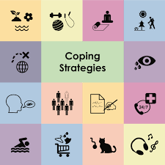
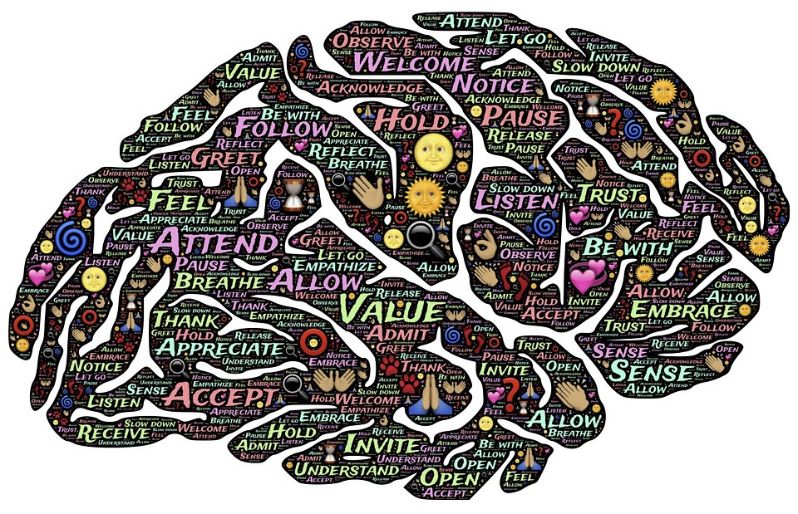
Coping Strategies
What is meant by healthy and unhealthy coping strategies?
Notes:
To discuss with the class: they can share ideas of some healthy and unhealthy coping strategies (if self-harm comes up, it is an unhealthy coping strategy, it doesn’t necessarily mean that a person has mental ill health if they are self-harming)

Slide 15
Discuss in Pairs
1. Sharing emotions and personal details on social media
2. Working excessively on school work to cope with anxiety about studies
3. Using energy drinks to boost energy and mood when feeling the need for a ‘pick-me-up’
4. Punching the wall (or hurting themselves in other ways) to manage difficult feelings like anger
Notes:
Ask students to consider the risks associated with each behavior and what an alternative healthier coping strategy would be. Risks can include immediate/short term, long term risks, as well as social and emotional risks. They can turn to the person next to them and have a quick discussion.
To mention that often people become addicted to drugs and alcohol or may develop an eating disorder, as they have not learnt various coping strategies to manage their emotions and cope with difficult situations that impact us in our lives. Resilience is about our ability to bounce back and recover from stressful and adverse situations and events in life.
Learning coping strategies is proven to increase one’s resilience, improve mental health, enhance the quality of one’s life increases our emotional intelligence and our self-esteem (how we feel about ourselves) – which are all highly important.
Intelligence is not just about academic intelligence, but also about social and emotional intelligence – how we communicate with other’s and ourselves etc.

Slide 16
STOPP Skill
Notes:
Show video to students of the STOPP skill – mention that this is a very successful technique that is used in DBT therapy (Dialectical Behaviour Therapy) for those individuals who have been diagnosed with Emotional Unstable Personality Disorder, i.e. people who struggle to regulate their emotions. They experience very heightened emotions and often find it difficult to manage and calm down from such heightened emotions. This technique can often pull people out of crisis. It’s useful irrespective of whether one experiences heightened emotions, as it teaches one to reflect and better manage their reactions and responses in various situations.
Recommended reading – Mindfulness and the Art of Managing Anger – Meditations on Clearing the Red Mist by Mike Fisher, he is the founder of BAAM (British Association of Anger Management)

Slide 17
Summary of Today’s Lesson
• We all have mental health
• We need to look after our mental health in the same way that we look after our physical health
• There are lots of things we can do to manage everyday feelings and stress levels
• If we experience overwhelming feelings, we should talk to an adult that we trust and think about using healthy coping strategies
Notes:
Read through slide, to re-cap learning from today’s lesson and check if students have any questions

Slide 18
Wellbeing Toolkit
Create a wellbeing toolkit for yourself.
It could include:
A collection of photos, memes or crafts that lift your mood
A list of strategies you could use to support your wellbeing if things are difficult
A snapshot of people, places and websites that offer support and help
Notes:
Teacher Notes
These activities can be used to extend the learning, either in lessons or as home learning.

